Slide 1

Building Successful Communities,
One at a time

Slide 2
Who we are?
The Mobile Family Success Center of Middlesex County team consists of:
  Rosela Roman - Director
  Megan Carduner-Volunteer and Community Partnership Coordinator
  Rosmery Suarez- Family Partner
We work in tandem with the communities we serve to identify needs and offer programming that will fulfill those needs.

Slide 3
What is the Mobile Family Success Center of Middlesex County?
The Mobile Family Success Center of Middlesex County (MFSC) is a community-based, family centered program, utilizing neighborhood gathering places where any community resident can go for family support, information and services.
The MFSC goal is to strengthen individual and family functioning and empower people to acquire the knowledge, skills, and resources they need to succeed and to provide an optimal environment for children’s development throughout Middlesex County.

Slide 4
Where are we located?
While the MFSC staff are located at the Catholic Charities, Diocese of Metuchen Office in Edison, NJ, there is no central location for the MFSC.
We are community based and do our programs in community centers, public housing authorities, libraries, schools, YMCA sites, churches and other community locations.

Slide 5
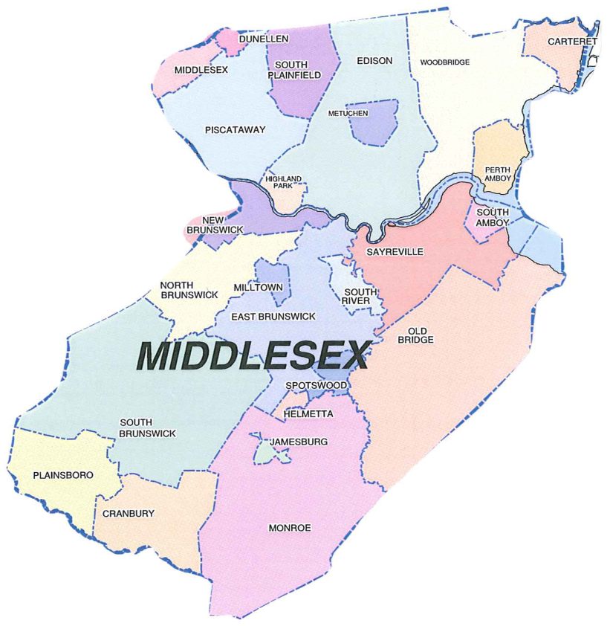
We focus on five Municipalities
East Brunswick
Edison
North Brunswick
Sayreville
Piscataway
Everyone is welcome to come and participate in our programs. They are public events unless otherwise noted.

Slide 6
Middlesex County has 4 Centers
Greenway Family Success Center located in Fords
Bayside Family Success Center located in Perth Amboy
Harmony Family Success Center located in New Brunswick
Mobile Family Success Center located in Edison. Only mobile center on wheels in the whole state of NJ.

Slide 7

MFSC provides the following services:
Access to Health
Parent-Child Activities
Housing
Life Skills
Employment
Advocacy
General Information
Referrals as needed

Slide 8
What sort of programming do you offer?
Our programming is based on community needs. Some programming examples are Resume Writing Skills, Creating a Budget, Health Workshops or social programs like Mommy and Me groups or Family Fun events.
These programs are presented and developed by our staff, volunteers and our partnerships with other professional organizations.

Slide 9
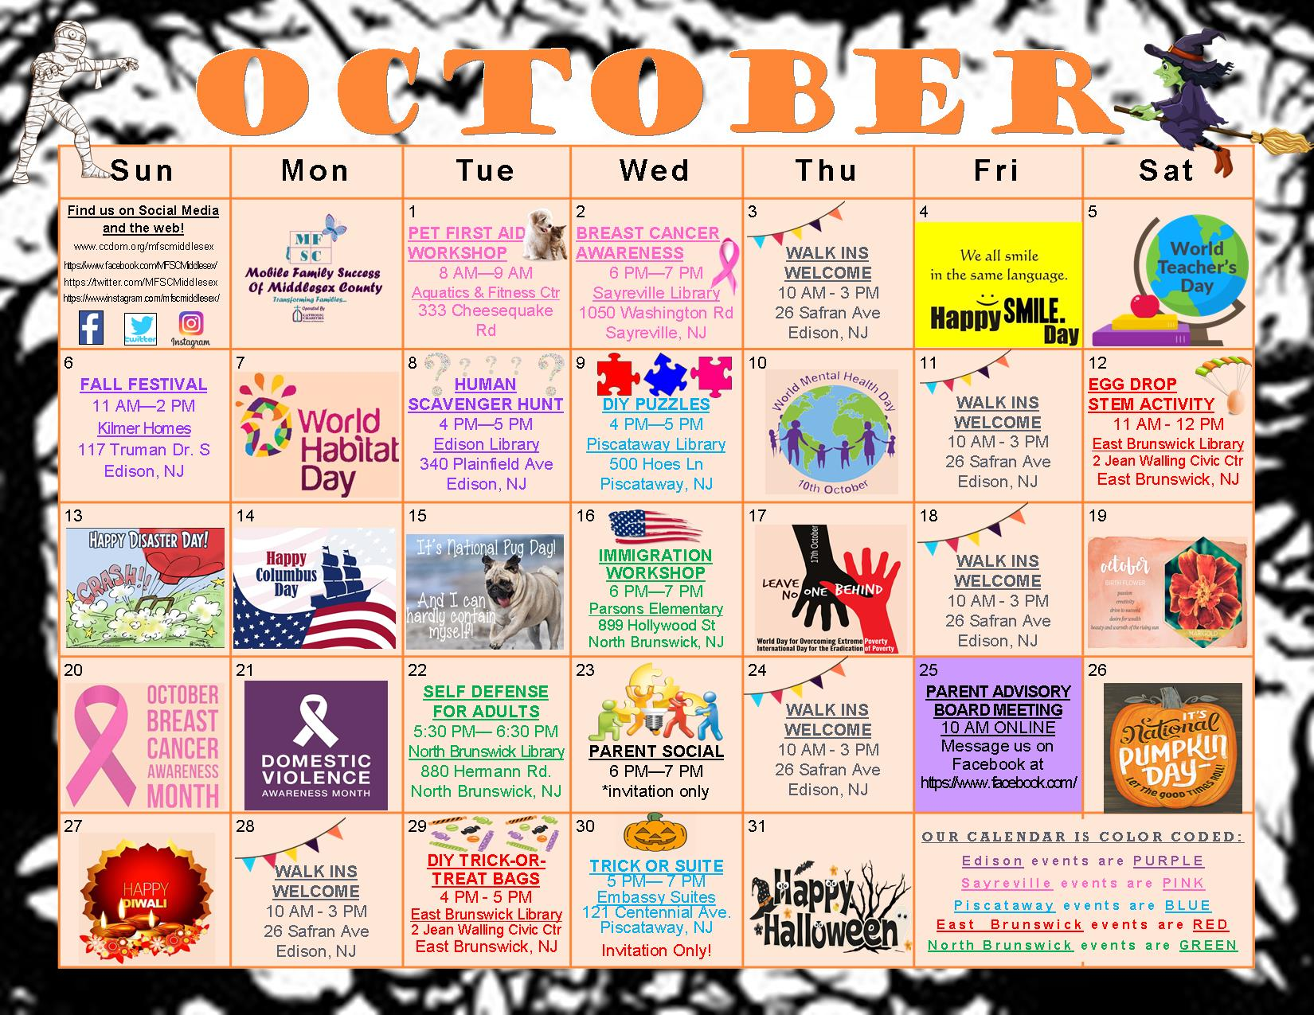
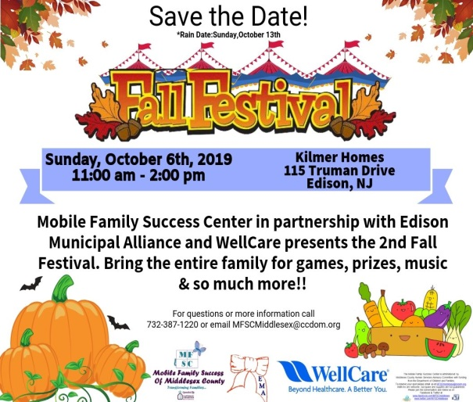
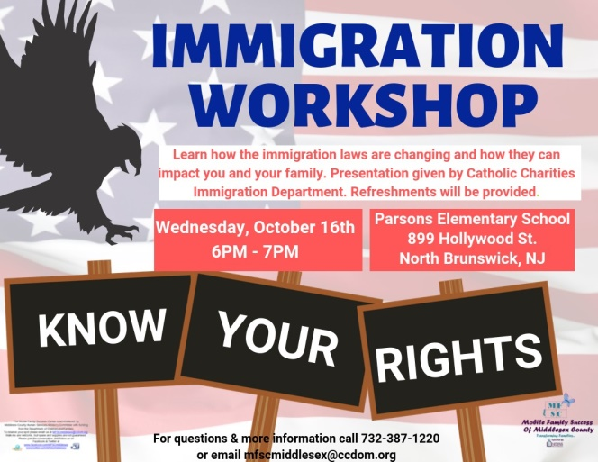
Monthly Calendars
Our monthly calendars are emailed to all of our families and community partners. They can also be found on our website and social media pages and are available in English and Spanish.

Slide 10
EVENTS
MFSC events are posted on our website and social media pages:
www.ccdom.org/mfscmiddlesex
https://www.facebook.com/MFSCMiddlesex/
https://twitter.com/MFSCMiddlesex
Our events are also advertised at our different sites and some local businesses.

Slide 11
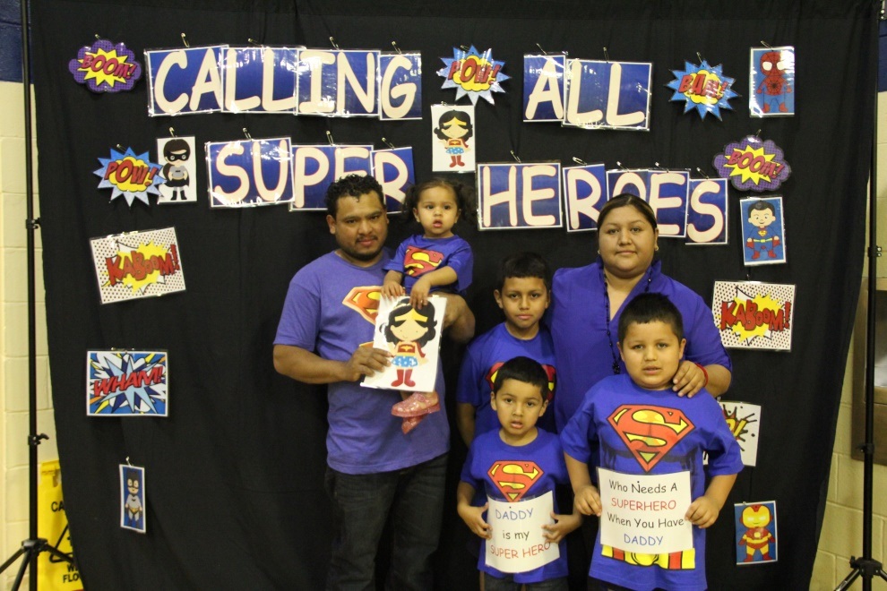
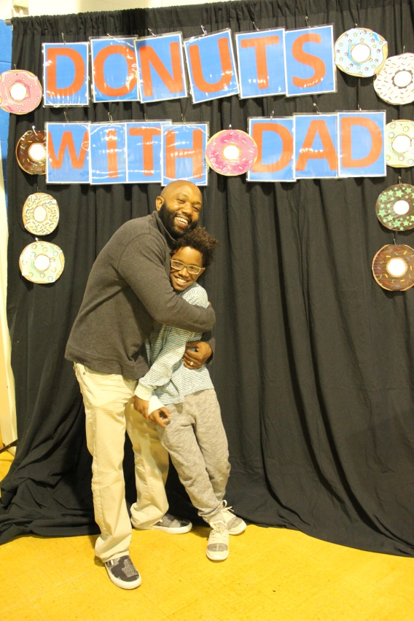
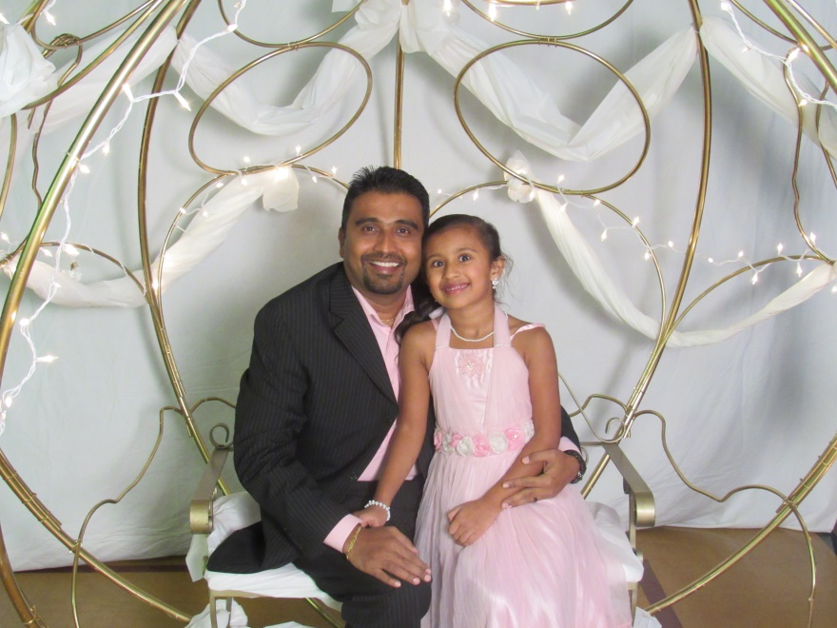
We hosted several fatherhood initiatives this year including a Princess Ball.

Slide 12
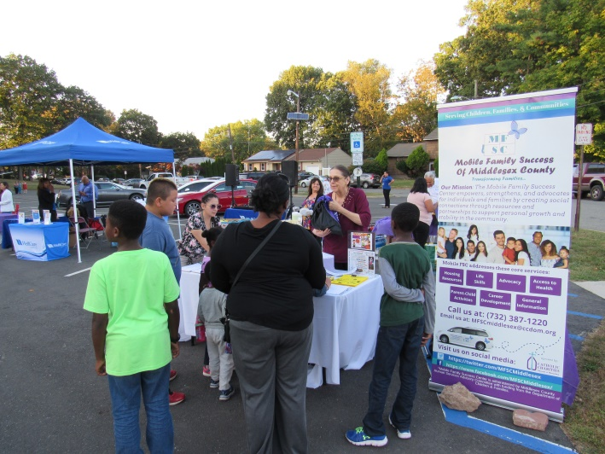
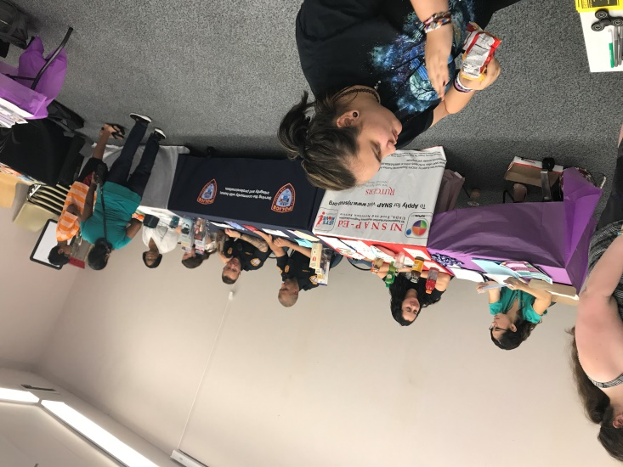
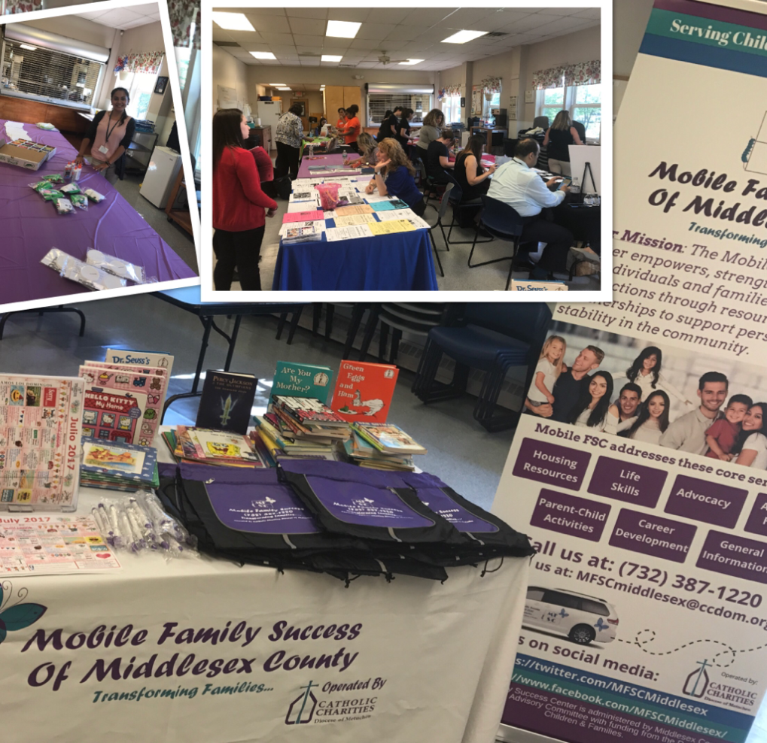
We have also held several resource fairs throughout the year.

Slide 13
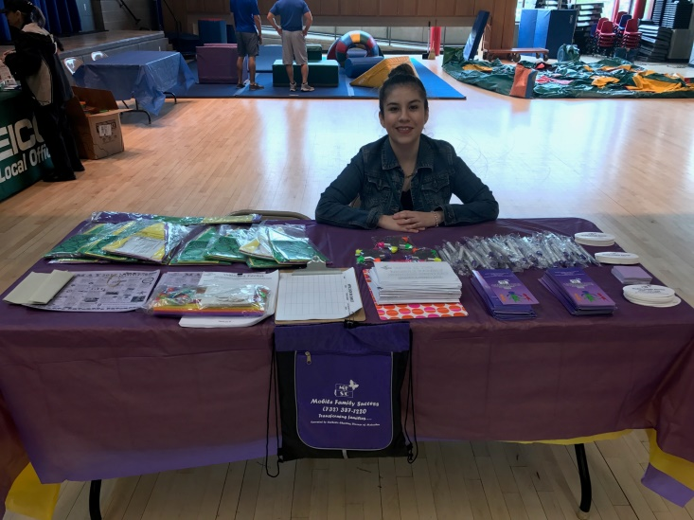
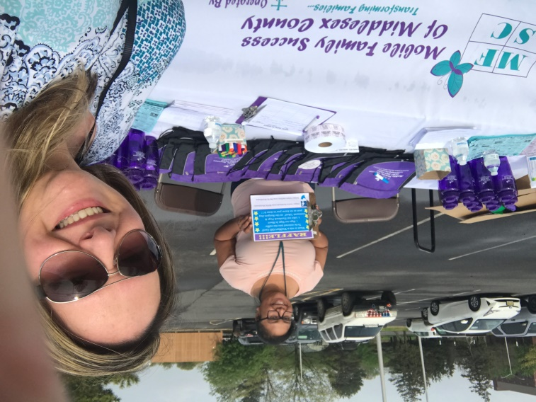
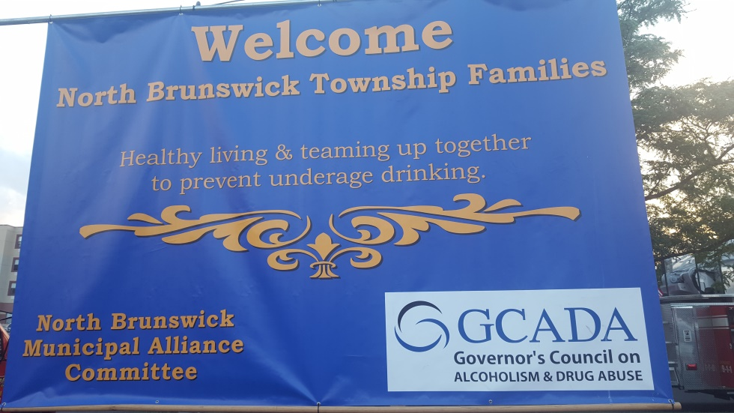
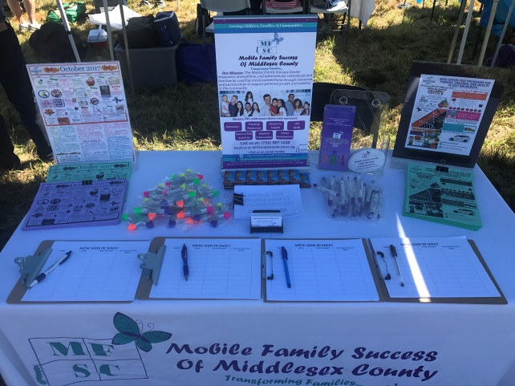
We attend community events such as Rutgers Day, Sayreville Day, & National Night Out Events

Slide 14
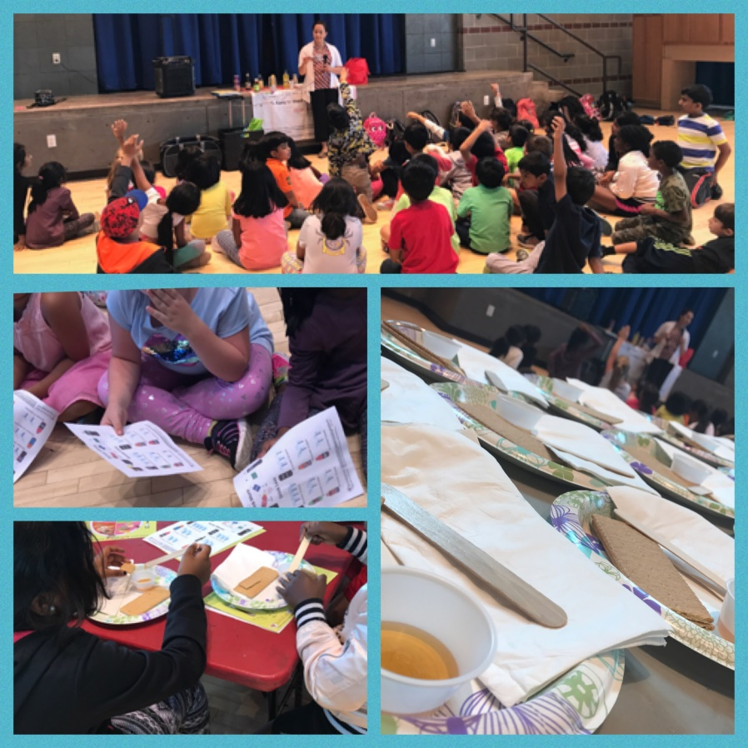
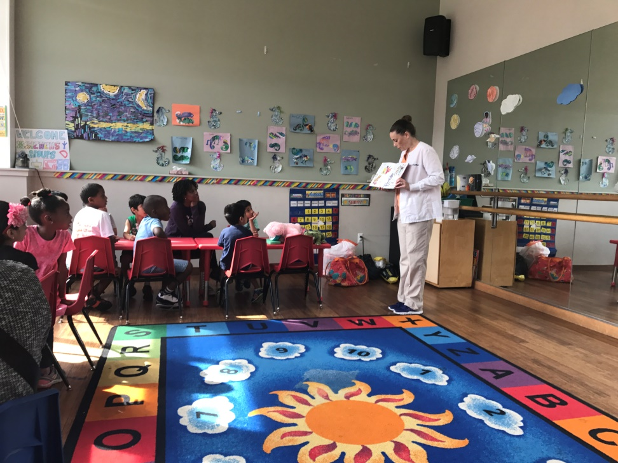
We host educational workshops presented by professionals in specific fields

Slide 15
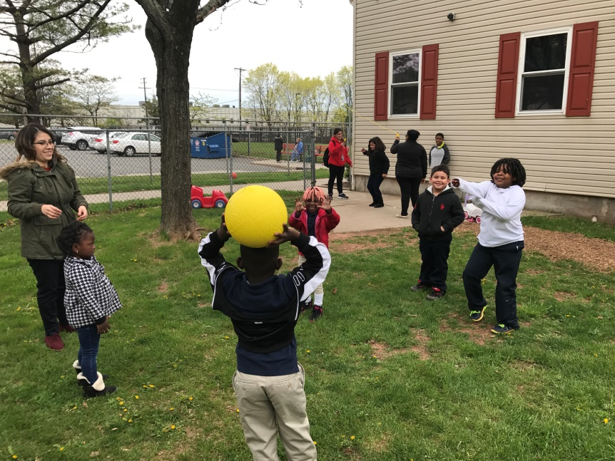
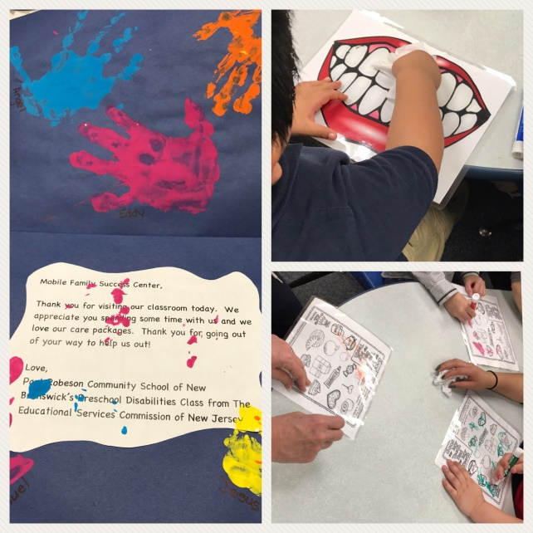
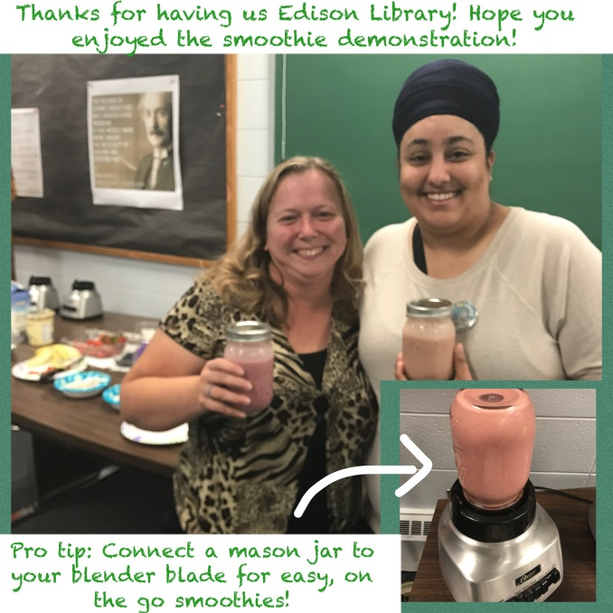
We host events that promote a healthy lifestyle such as healthy eating and exercise.

Slide 16
ALL SERVICES ARE FREE

Slide 17
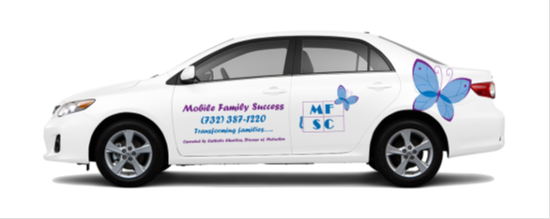

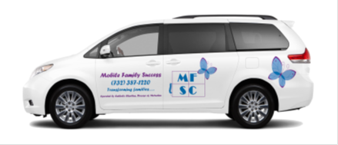
Mobile Family Success Center
We are always
on the go!

Slide 18
Why are these services important?
The services that the MFSC provides are important because it helps build stronger families. Families find and develop resources with MFSC programming. Stronger families use the resources at hand to avoid crisis situations and empower their children to succeed.
MFSC builds the community centers that no longer exist.
Additional services can include information and referral as well as family success planning and some case management.

Slide 19
Where can I find information?
The MFSC has a Facebook, Instragram, & Twitter Page with updated calendars and information on upcoming programs:
  Find us at Follow us on Twitter @MFSCmiddlesex
  Like us on Facebook at MFSCmiddlesex
Get on our Email List to receive updates and our monthly program calendar.
  Our website is: www.ccdom.org/MFSCmiddlesex
Call us: 732-387-1220

